Slide 1
WorkingWithR
資料科學 Data Science
張家銘 Jia-Ming Chang
政治大學資訊科學系
The slide is only for educational purposes. If any infringement, please contact me. We will correct immediately.

Slide 2
Copyright declaration 版權說明
Some of the figures in this presentation are taken from "An Introduction to Statistical Learning, with applications in R" (Springer, 2013) with permission from the authors: G. James, D. Witten, T. Hastie and R. Tibshirani.
The web site of the book
The credit of individual is indicated in the bottom part of the slide.
ie.,

Slide 3
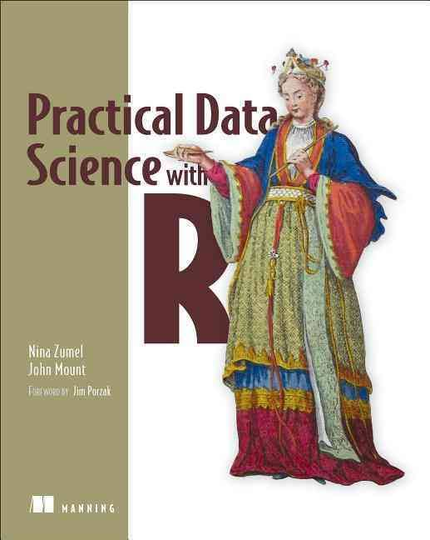
Copyright declaration 版權說明
Some of the figures in this presentation are taken from "Practical Data Science with R (Manning, 2019)”
The web site of the book
The credit of individual is indicated in the bottom part of the slide.
ie.,

Slide 4
Copyright declaration 版權說明
Some of the figures in this presentation are taken from "R for Data Science” under the Creative Commons Attribution-NonCommercial-NoDerivs 3.0 License.
The web site of the book
The credit of individual is indicated in the bottom part.
ie.,

Slide 5
Data Science this week
How much Math & Stats do I need on my Data Science resume?
https://www.datascienceweekly.org/articles/how-much-math-stats-do-i-need-on-my-data-science-resume
That said, there are a few mainstays that, irrespective of role, you should be demonstrating on your resume. Either through your academic courses/coursework, online courses you've taken, or project work you've completed. Specifically:

Slide 6
Data Science this week
Specifically
Linear algebra (and ideally basic multivariate calculus)
Regression ... linear regression and the things that violate the assumptions of linear models (e.g., autocorrelation in time series data, non-independent observations)
Probability theory ... especially Bayes' Law and Central Limit Theorem
Numerical analysis (e.g., time series analysis and forecasting)
Core machine learning methods (clustering, decision trees, k-NN)

Slide 7
Recap from the last week

Slide 8
Data Science
The data scientist is responsible for
Data : acquiring the data, managing the data
Modeling: choosing the modeling technique, writing the code
Evaluation: verifying the results

Slide 9
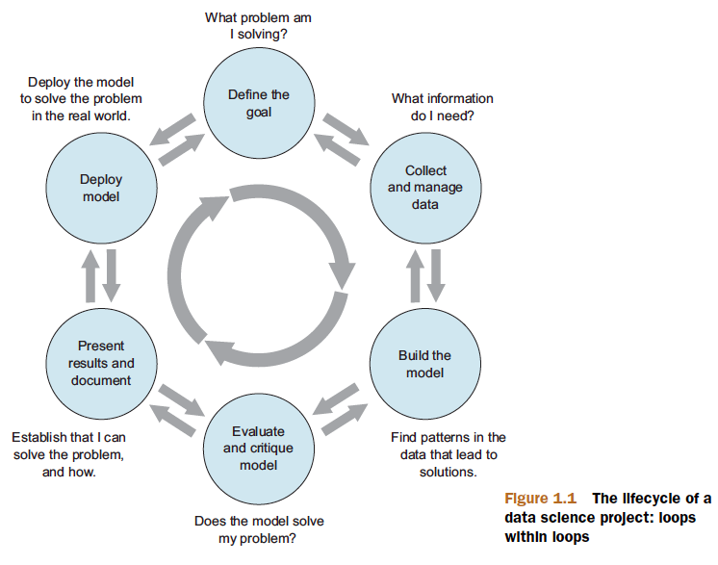
Data Science project
Find your own data set
Before midterm
Figure 1.1, Practical Data Science with R by Nina Zumel,John Mount

Slide 10
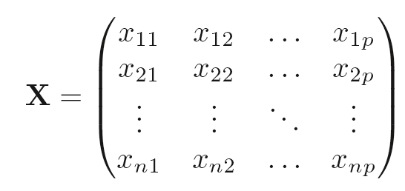
X denotes a n x p matrix
Practical Data Science with R by Nina Zumel, John Mount

Slide 11
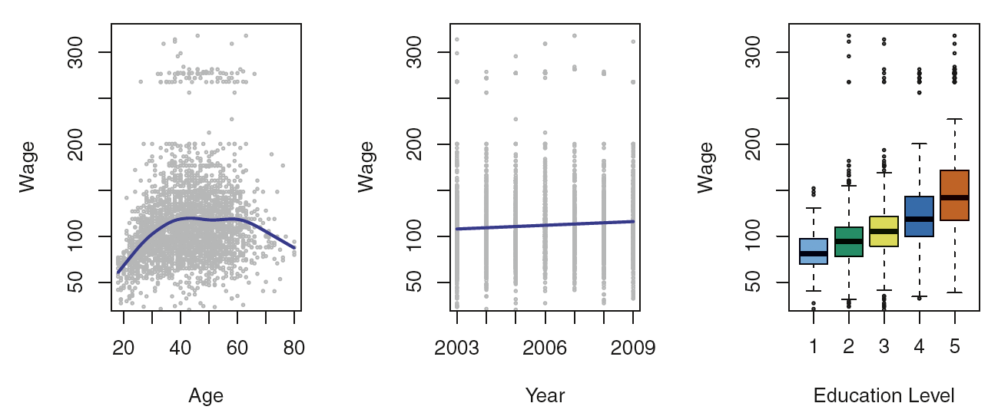
Supvervised
Figure 1.1, An Introduction to Statistical Learning with Applications in R by Gareth James, Daniela Witten, Trevor Hastie, Robert Tibshirani

Slide 12
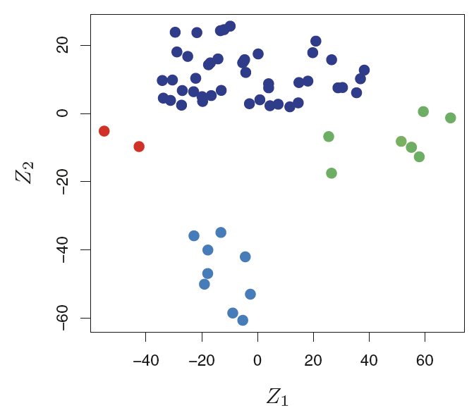
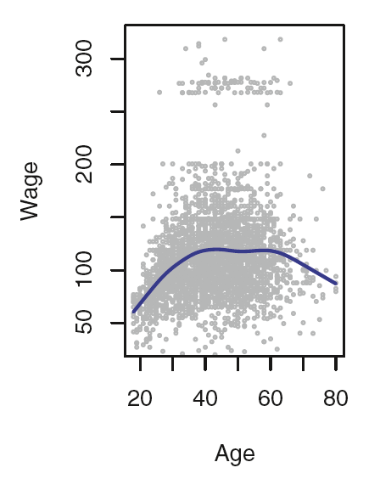
Regression v.s. Classification
Figure 1.1 & 1.4, An Introduction to Statistical Learning with Applications in R by Gareth James, Daniela Witten, Trevor Hastie, Robert Tibshirani

Slide 13
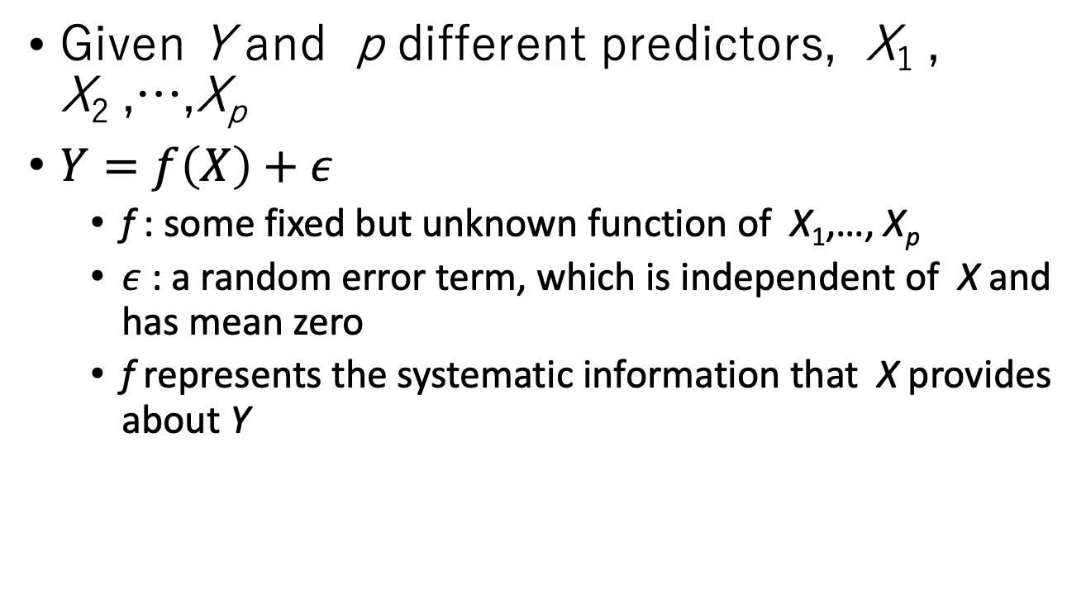
Modeling
Given Y and p different predictors, X₁ , X₂ ,…,X_{p}
$Y=f\left(X\right)+ε$
f : some fixed but unknown function of X₁,…, X_{p}
$ε$ : a random error term, which is independent of X and has mean zero
f represents the systematic information that X provides about Y
An Introduction to Statistical Learning with Applications in R by Gareth James, Daniela Witten, Trevor Hastie, Robert Tibshirani

Slide 14
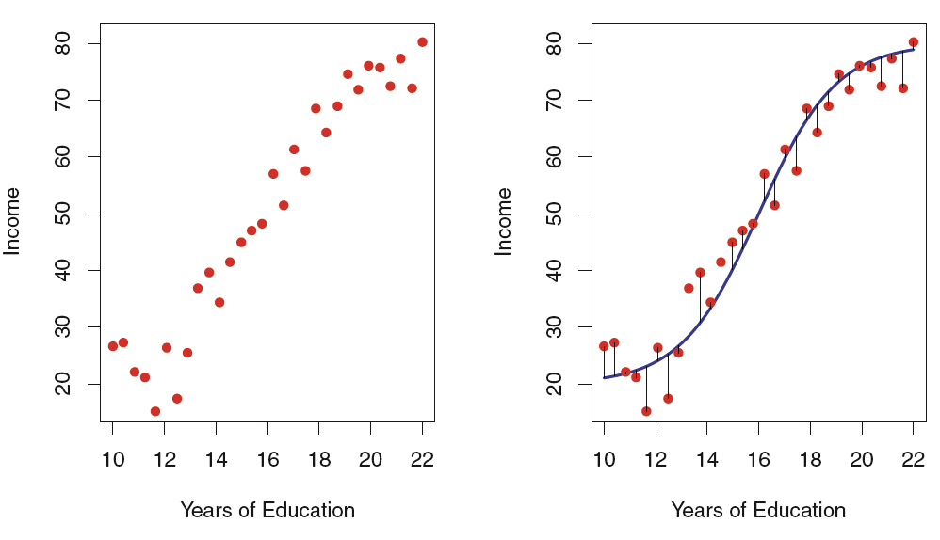
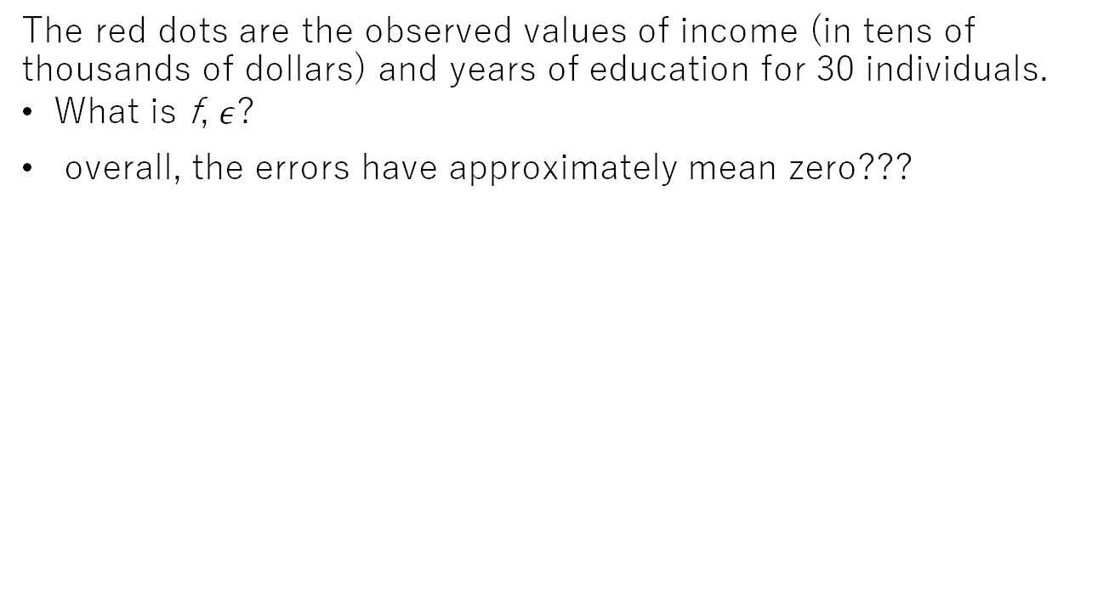
The income data set
The red dots are the observed values of income (in tens of thousands of dollars) and years of education for 30 individuals.
What is f, $ε$?
overall, the errors have approximately mean zero???
Figure2.2, An Introduction to Statistical Learning with Applications in R by Gareth James, Daniela Witten, Trevor Hastie, Robert Tibshirani

Slide 15
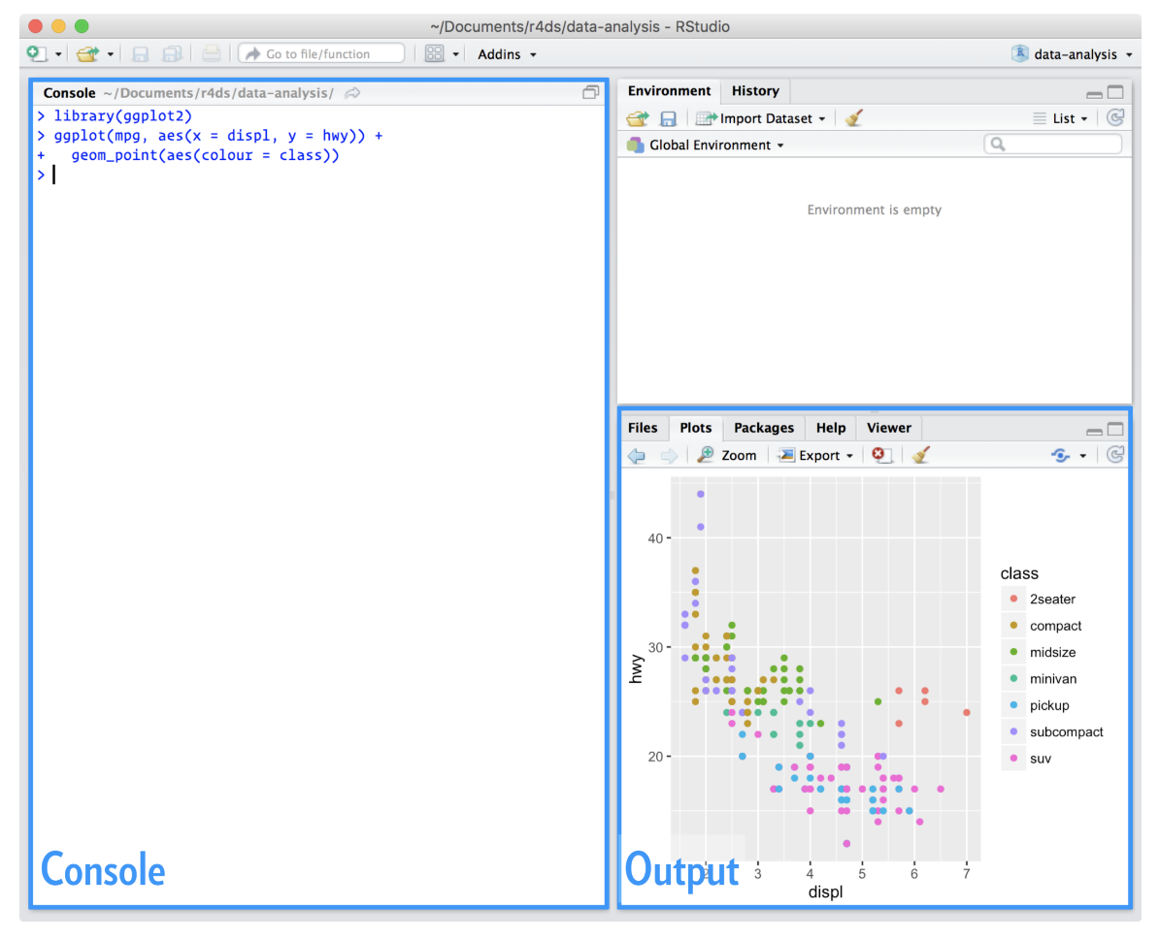
Installing RStudio
An integrated development environment, or IDE, for R programming.
https://www.rstudio.com/products/rstudio/download/
Figure 1.4.2, R for Data Science by Garrett Grolemund, Hadley Wickham

Slide 16
Basic Commands
?funcname
set.seed(1303)
rnorm(50)
sessionInfo()
what packages are present in your session
An Introduction to Statistical Learning with Applications in R by Gareth James, Daniela Witten, Trevor Hastie, Robert Tibshirani

Slide 17
Today
appendix A: Working with R and other tools
Cha 4. Workflow: basics
Cha27. R Markdown

Slide 18
Example Code
Moodle
code02.zip
Run R script from command line
Rscript code02/<example>.R

Slide 19
Distributions

Slide 20
Distributions
the normal distribution
the lognormal distribution
the binomial distribution.
Practical Data Science with R by Nina Zumel, John Mount
Notes:
Can someone tell me the difference between them?

Slide 21
Normal distribution
Normal or Gaussian distribution
classic symmetric bell-shaped curve
Credit by https://www.mathsisfun.com/data/standard-normal-distribution.html

Slide 22
Normal distribution
Repeated measurements will tend to fall into a normal distribution.
Central limit theorem says that when you’re observing the sum (or mean) of many independent, bounded variance random variables, the distribution of your observations will approach the normal as you collect more data.
Practical Data Science with R by Nina Zumel, John Mount
Notes:
Central limit theorem ?

Slide 23
Plotting the normal density
normalDist.R
The theoretical
library(ggplot2)
x <- seq(from=-5, to=5, length.out=100) #the interval[-5 5]
f <- dnorm(x) # normal with mean 0 and sd 1
ggplot(data.frame(x=x,y=f), aes(x=x,y=y)) + geom_line()
Practical Data Science with R by Nina Zumel, John Mount

Slide 24
Plotting the normal density
normalDist.R
An empirical
u <- rnorm(1000)
ggplot(data.frame(x=u), aes(x=x)) + geom_density() + geom_line(data=data.frame(x=x,y=f), aes(x=x,y=y), linetype=2)
Practical Data Science with R by Nina Zumel, John Mount

Slide 25
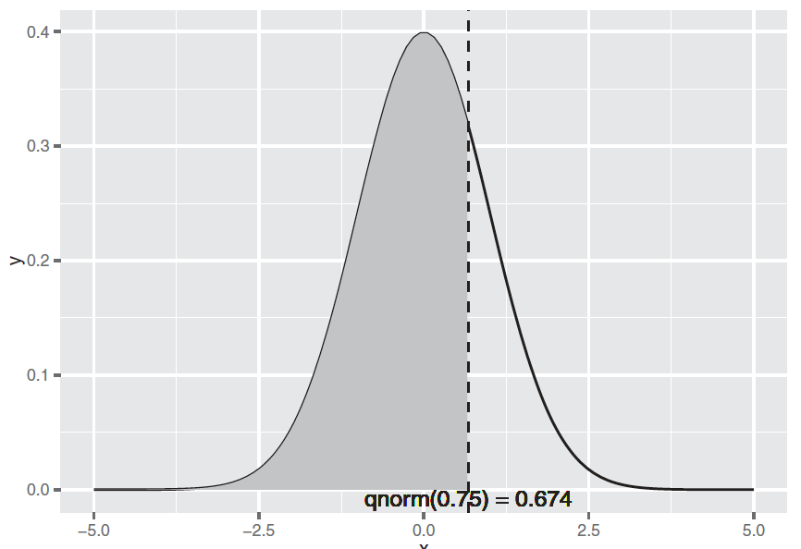
Illustrating x < qnorm(0.75)
cumDist.R
qnorm(0.75)
pnorm(0.6744898)
Figure B.3, Practical Data Science with R by Nina Zumel, John Mount

Slide 26
Illustrating x < qnorm(0.75)
x <- seq(from=-5, to=5, length.out=100)
f <- dnorm(x)
nframe <- data.frame(x=x,y=f)
line <- qnorm(0.75)
xstr <- sprintf("qnorm(0.75) = %1.3f", line)
nframe75 <- subset(nframe, nframe$x < line)
ggplot(nframe, aes(x=x,y=y)) + geom_line() +
geom_area(data=nframe75, aes(x=x,y=y), fill="gray") +
geom_vline(aes(xintercept=line), linetype=2) +
geom_text(x=line, y=0, label=xstr, vjust=1)
Figure B.3, Practical Data Science with R by Nina Zumel, John Mount

Slide 27
Summarizing R’s distribution naming conventions
dDIST(x, ...)
the distribution function (PDF) that returns the probability of observing the value x.
rDIST(n, ...)
the random number generation function that returns n values drawn from the distribution DIST.
qDIST(p, ...)
the quantile function that returns the x corresponding to the pth percentile of DIST.
pDIST(x, ...)
the cumulative distribution function (CDF) that returns the probability of observing a value less than x.
Practical Data Science with R by Nina Zumel, John Mount​

Slide 28
Summarizing R’s distribution naming conventions
qDIST(p, ...)
the quantile function that returns the x corresponding to the pth percentile of DIST.
lower.tail=F : will cause qDIST(p, ...) to return the x that corresponds to the 1 - pth percentile of DIST.
pDIST(x, ...)
the cumulative distribution function (CDF) that returns the probability of observing a value less than x.
lower.tail=F : will return the probability of observing a value greater than x (the area under the right tail).
Practical Data Science with R by Nina Zumel, John Mount​

Slide 29
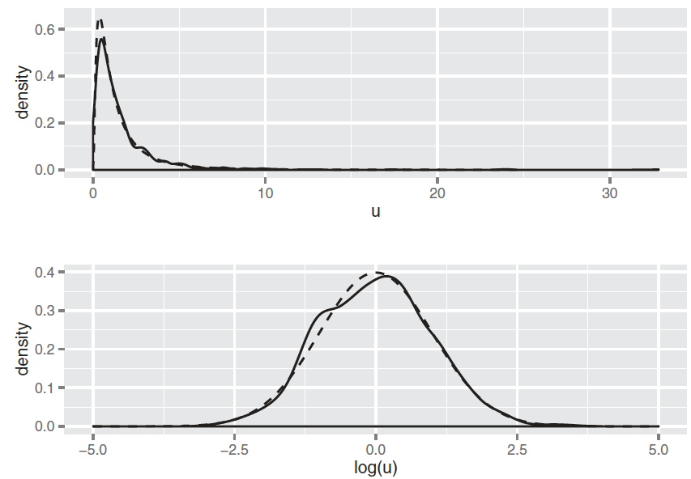
Lognormal distribution
distribution of a random variable X whose natural log, log(X), is normally distributed.
The distribution of highly skewed positive data (like incomes, sales, or stock prices) can often be modeled as a lognormal distribution.
FigureB.4, Practical Data Science with R by Nina Zumel, John Mount​

Slide 30
Binomial distribution, Bin(n,p)
the discrete probability distribution of the number of successes in a sequence of n independent experiments, each asking a yes–no question, and each with its own boolean-valued outcome: yes with probability p

Slide 31
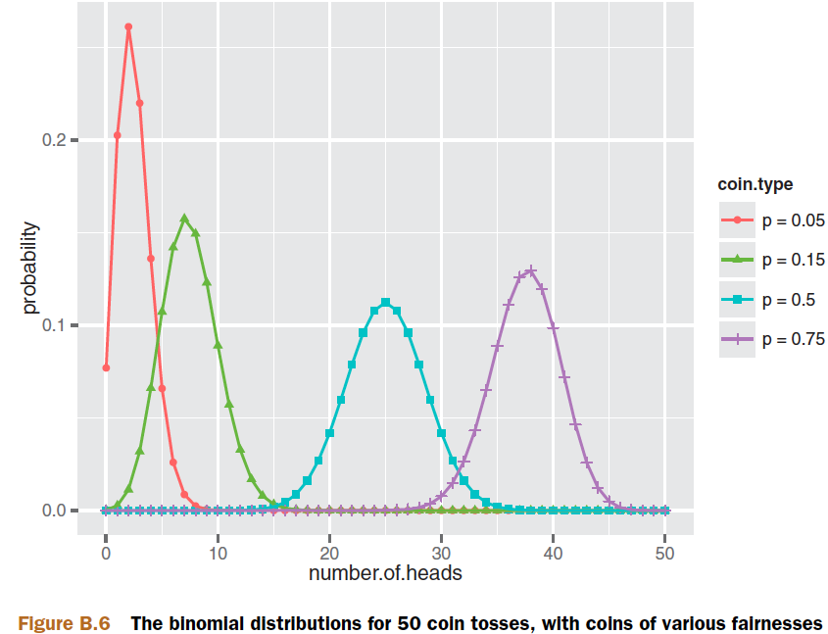
Binomial distribution
probability of observing k heads when you flip that coin N times.
a
Figure B.6, Practical Data Science with R by Nina Zumel, John Mount​

Slide 32
Plotting the binomial distribution
plotBinomial.R
library(ggplot2)
numflips <- 50
x <- 0:numflips
p <- c(0.05, 0.15, 0.5, 0.75)
plabels <- paste("p =", p)
flips <- NULL
for(i in 1:length(p)) {
coin <- p[i]
label <- plabels[i]
tmp <- data.frame(number.of.heads=x,
probability = dbinom(x, numflips, coin),
coin.type = label)
flips <- rbind(flips, tmp)
}
ggplot(flips, aes(x=number.of.heads, y=probability)) +
geom_point(aes(color=coin.type, shape=coin.type)) +
geom_line(aes(color=coin.type))
Figure B.6, Practical Data Science with R by Nina Zumel, John Mount​

Slide 33
Binomial distribution
binomial.R
probability of observing k heads when you flip that coin N times.
nflips <- 100
nheads <- c(25, 45, 50, 60) # number of heads
Practical Data Science with R by Nina Zumel, John Mount​

Slide 34
Binomial distribution
binomial.R
# what are the probabilities of observing at most that number of heads on a fair coin?
P(X ≤ nheads)
left.tail <- pbinom(nheads, nflips, 0.5)
sprintf("%2.2f", left.tail)
Practical Data Science with R by Nina Zumel, John Mount​

Slide 35
Binomial distribution
binomial.R
# the probabilities of observing more than that number of heads on a fair coin?
P(X>nheads)
right.tail <- pbinom(nheads, nflips, 0.5, lower.tail=F)
sprintf("%2.2f", right.tail)
Practical Data Science with R by Nina Zumel, John Mount​

Slide 36
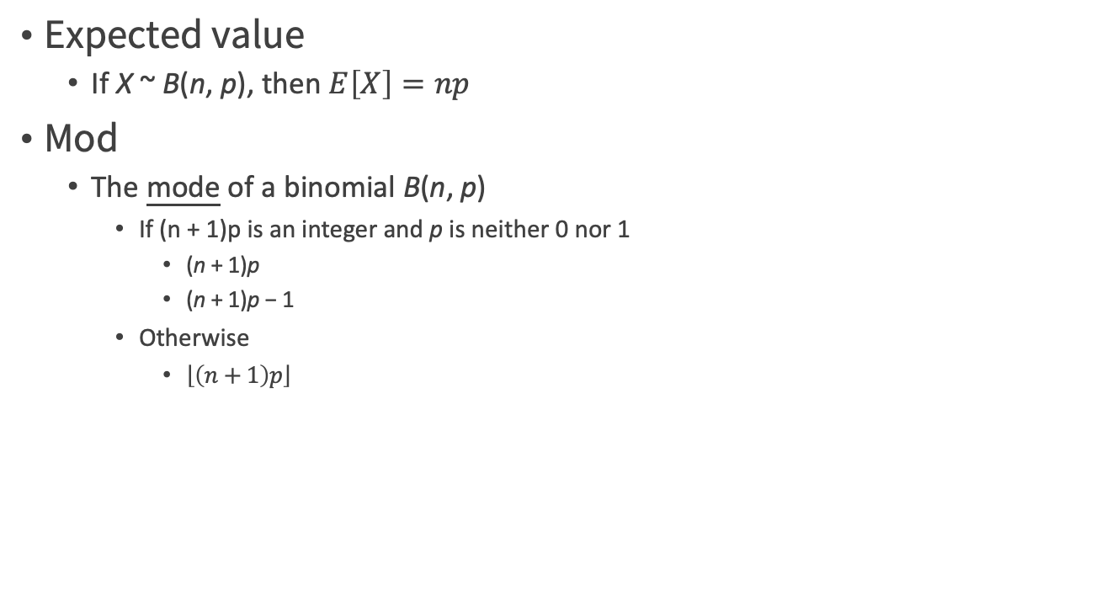
Binomial distribution
Expected value
If X ~ B(n, p), then $E\left[X\right]=np$
Mod
The mode of a binomial B(n, p)
If (n + 1)p is an integer and p is neither 0 nor 1
(n + 1)p
(n + 1)p − 1
Otherwise
$\left\lfloor \left(n+1\right)p\right\rfloor$

Slide 37
The accuracy of the Model

Slide 38
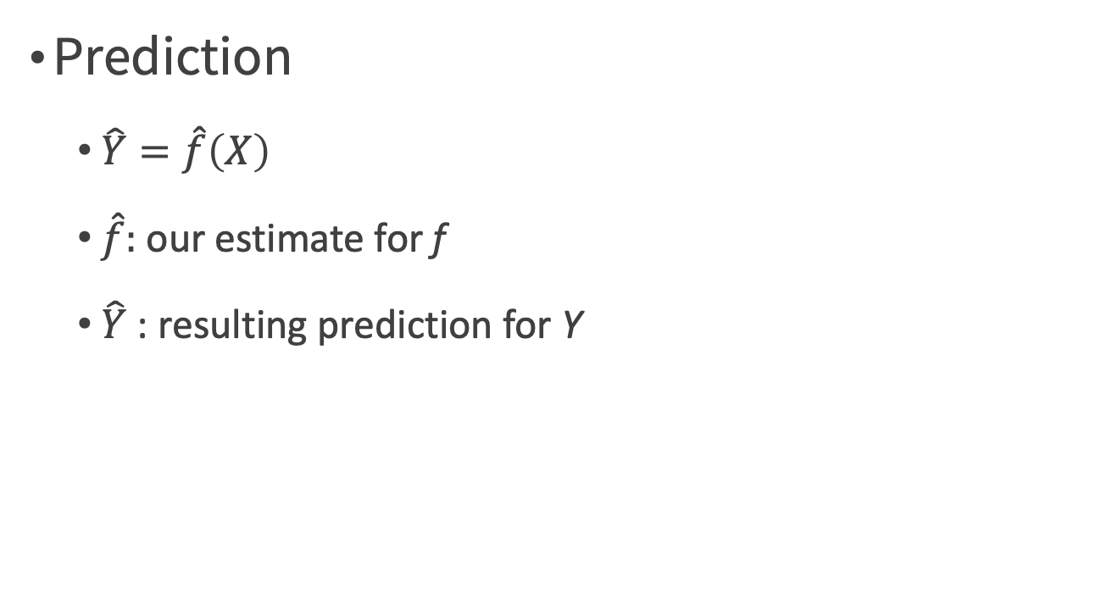
Why Estimate f?
Prediction
$\hat{Y}=\hat{f}\left(X\right)$
$\hat{f}:$ our estimate for f
$\hat{Y}$ : resulting prediction for Y
An Introduction to Statistical Learning with Applications in R by Gareth James, Daniela Witten, Trevor Hastie, Robert Tibshirani

Slide 39
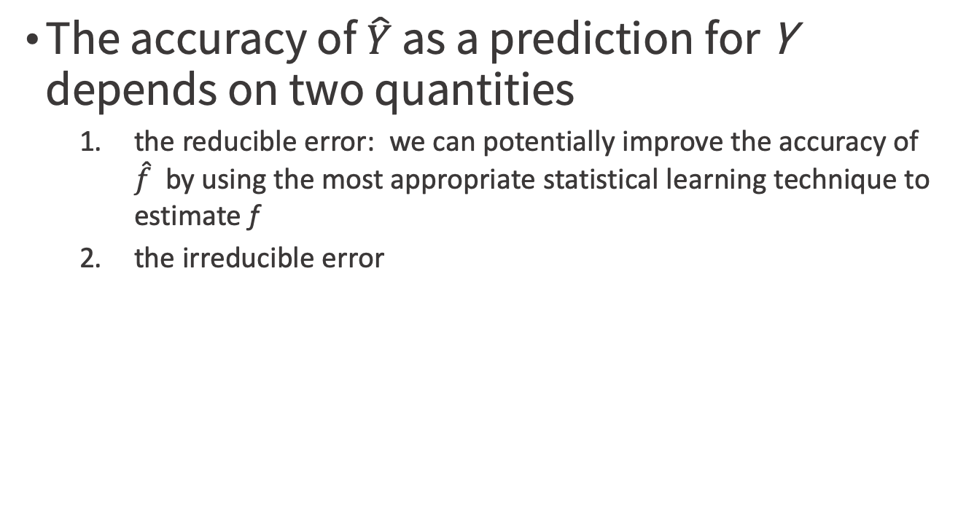

$$\hat{Y}=\hat{f}\left(X\right)$$
The accuracy of $\hat{Y}$ as a prediction for Y depends on two quantities
the reducible error: we can potentially improve the accuracy of $\hat{f}$ by using the most appropriate statistical learning technique to estimate f
the irreducible error
An Introduction to Statistical Learning with Applications in R by Gareth James, Daniela Witten, Trevor Hastie, Robert Tibshirani

Slide 40
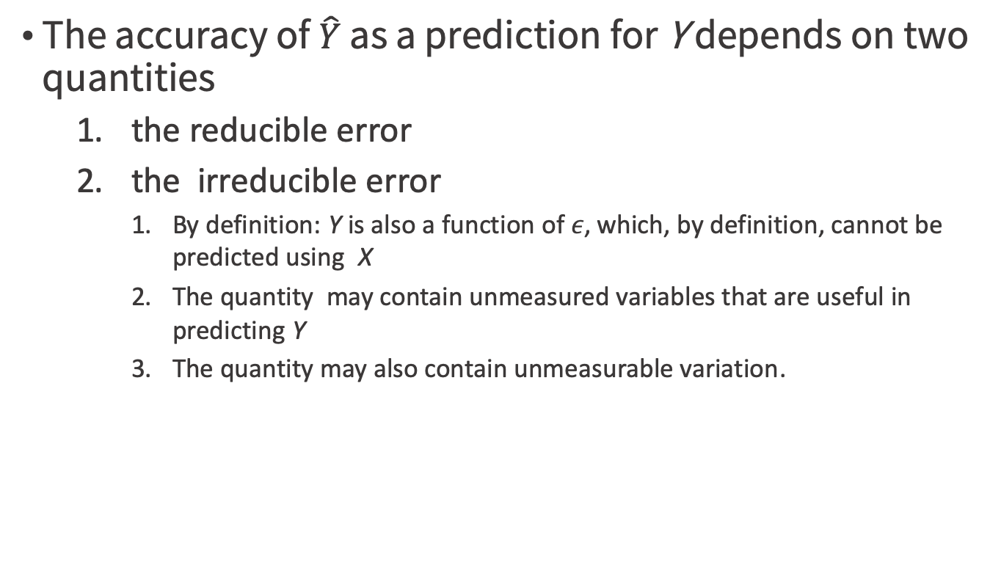
$$\hat{Y}=\hat{f}\left(X\right)$$
The accuracy of $\hat{Y}$ as a prediction for Y depends on two quantities
the reducible error
the irreducible error
By definition: Y is also a function of $ε$, which, by definition, cannot be predicted using X
The quantity may contain unmeasured variables that are useful in predicting Y
The quantity may also contain unmeasurable variation.
An Introduction to Statistical Learning with Applications in R by Gareth James, Daniela Witten, Trevor Hastie, Robert Tibshirani

Slide 41
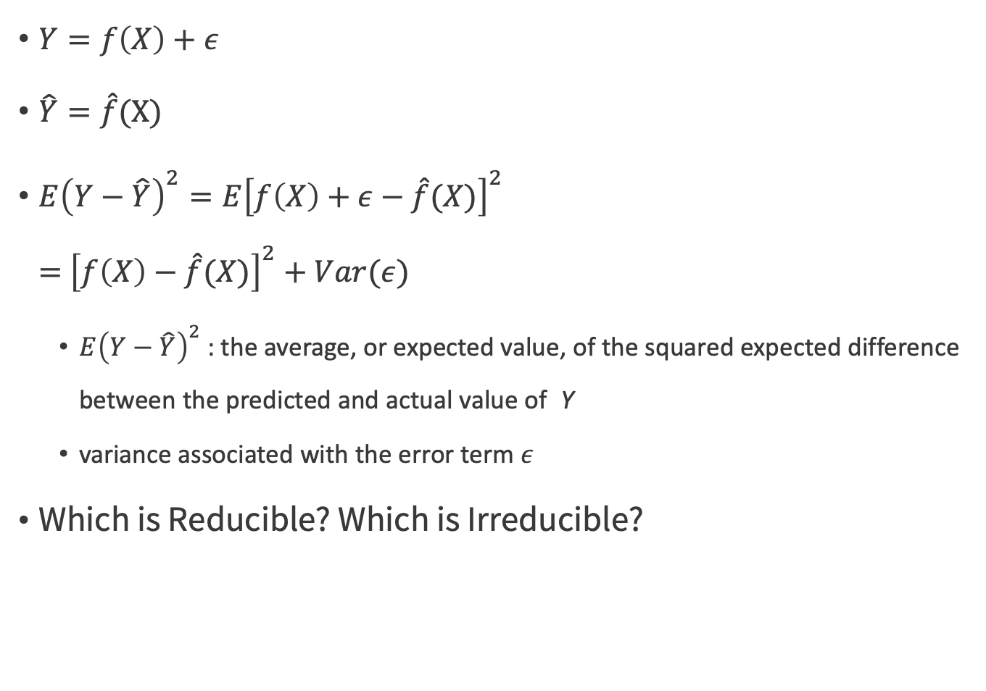
$Y=f\left(X\right)+ε$
$\hat{Y}=\hat{f}$(X)
$E{\left(Y−\hat{Y}\right)}^{2}=E{\left[f\left(X\right)+ε−\hat{f}(X)\right]}^{2}$ $=$ ${\left[f\left(X\right)−\hat{f}(X)\right]}^{2}+Var(ε)$
$E{\left(Y−\hat{Y}\right)}^{2}$: the average, or expected value, of the squared expected difference between the predicted and actual value of Y
variance associated with the error term $ε$
Which is Reducible? Which is Irreducible?
An Introduction to Statistical Learning with Applications in R by Gareth James, Daniela Witten, Trevor Hastie, Robert Tibshirani

Slide 42
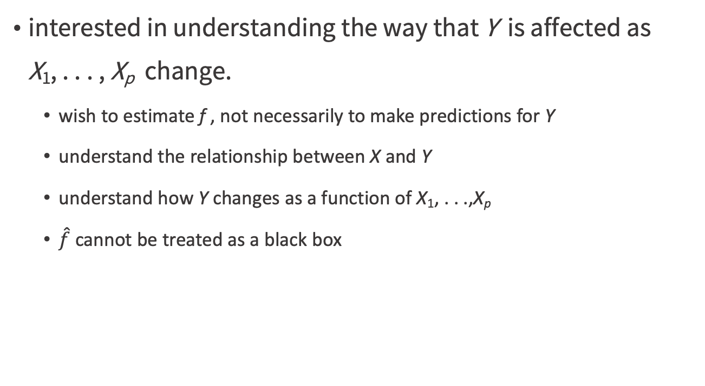
Inference v.s. prediction
interested in understanding the way that Y is affected as X₁, . . . , X_{p} change.
wish to estimate f , not necessarily to make predictions for Y
understand the relationship between X and Y
understand how Y changes as a function of X₁, . . .,X_{p}
$\hat{f}$ cannot be treated as a black box
An Introduction to Statistical Learning with Applications in R by Gareth James, Daniela Witten, Trevor Hastie, Robert Tibshirani

Slide 43
Inference
Which predictors are associated with the response?
What is the relationship between the response and each predictor?
Can the relationship between Y and each predictor be adequately summarized
using a linear equation
the relationship more complicated?
An Introduction to Statistical Learning with Applications in R by Gareth James, Daniela Witten, Trevor Hastie, Robert Tibshirani

Slide 44
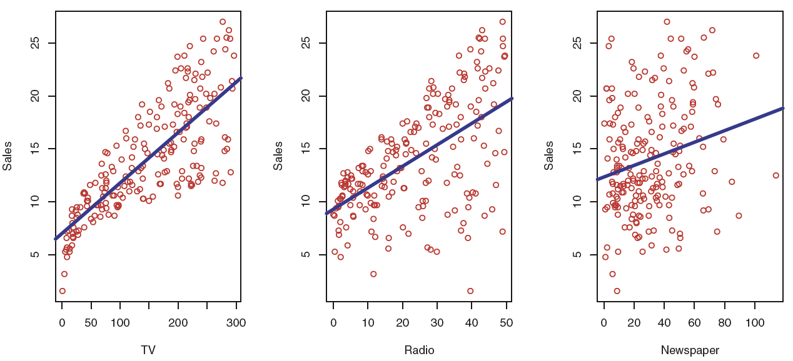
Inference
the Advertising data
Which media contribute to sales?
Which media generate the biggest boost in sales?
How much increase in sales is associated with a given increase in TV advertising?
Figure 2.1, An Introduction to Statistical Learning with Applications in R by Gareth James, Daniela Witten, Trevor Hastie, Robert Tibshirani

Slide 45
Working with R

Slide 46
R as a calculator
calculator.R
1 / 200 * 30
(59 + 73 + 2) / 3
sin(pi / 2)
R for Data Science by Garrett Grolemund, Hadley Wickham

Slide 47
Assignment
# create new objects with <-
x <- 3 * 4
<- (Recommend)
=
RStudio’s keyboard shortcut
Alt + - (the minus sign)
automagically surrounds <- with spaces
R for Data Science by Garrett Grolemund, Hadley Wickham

Slide 48
? Why <-, not =
assExam1.R
Binding values to function arguments
divide <- function(numerator, denominator) { numerator/denominator }
divide(2,1)
divide(denominator=2,numerator=1)
divide(denominator<-2,numerator<-1)
Which commend will give a wrong answer?

Slide 49
What’s in a name?
Object names must start with a letter, and can only contain
Letters
Numbers
_
.

Slide 50
What’s in a name?
Naming rule
snake_case where you separate lowercase words with _
i_use_snake_case min_hei
otherPeopleUseCamelCase
some.people.use.periods
And_aFew.People_RENOUNCEconvention

Slide 51
Fix assignment
this_is_a_really_long_name <- 2.5
Type “this” then press Cmd/Ctrl + ↑.
R for Data Science by Garrett Grolemund, Hadley Wickham

Slide 52
x<-5 vs x<<-5
sideEff.R
x<-1
good <- function() { x <- 5}
good()
print(x)
bad <- function() { x <<- 5}
bad()
print(x)
An Introduction to Statistical Learning with Applications in R by Gareth James, Daniela Witten, Trevor Hastie, Robert Tibshirani

Slide 53
Calling functions
seq(1, 10)
Type se
hit TAB.
Specify seq() by typing more (a “q”) to disambiguate, or by using ↑/↓ arrows to select.
If you want more help, press F1 to get all the details in help tab in the lower right pane.
Press TAB once more when you’ve selected the function you want.
R for Data Science by Garrett Grolemund, Hadley Wickham

Slide 54
“print to screen”
y <- seq(1, 10, length.out = 5)
(y <- seq(1, 10, length.out = 5))
R for Data Science by Garrett Grolemund, Hadley Wickham

Slide 55
Why does this code not work?
my_variable <- 10
my_varıable
R for Data Science by Garrett Grolemund, Hadley Wickham

Slide 56
What is wrong?
library(tidyverse)
ggplot(dota = mpg) + geom_point(mapping = aes(x = displ, y = hwy))
fliter(mpg, cyl = 8)
filter(diamond, carat > 3)
R for Data Science by Garrett Grolemund, Hadley Wickham

Slide 57
What is wrong?
library(tidyverse)
ggplot(data = mpg) + geom_point(mapping = aes(x = displ, y = hwy))
filter(mpg, cyl == 8)
filter(diamonds, carat > 3)
R for Data Science by Garrett Grolemund, Hadley Wickham

Slide 58
Keyboard Shortcuts
Press Alt + Shift + K. What happens?
R for Data Science by Garrett Grolemund, Hadley Wickham

Slide 59
RStudio IDE Cheat Sheet
https://www.rstudio.com/wp-content/uploads/2016/01/rstudio-IDE-cheatsheet.pdf
The RStudio IDE is the most popular integrated development environment for R.
Do you want to write, run, and debug your own R code?
Work collaboratively on R projects with version control?
Build packages or create documents and apps?
No matter what you do with R, the RStudio IDE can help you do it faster. This cheat sheet will guide you through the most useful features of the IDE, as well as the long list of keyboard shortcuts built into the RStudio IDE. Updated 01/16.
R for Data Science by Garrett Grolemund, Hadley Wickham

Slide 60
Vectorized Operations
vecOpe.R
Many R operations are called vectorized
R truth tables for boolean operators
c(T,T,F,F) == c(T,F,T,F)
c(T,T,F,F) & c(T,F,T,F)
c(T,T,F,F) | c(T,F,T,F)
An Introduction to Statistical Learning with Applications in R by Gareth James, Daniela Witten, Trevor Hastie, Robert Tibshirani

Slide 61
&, | vs &&, ||
c(T,T,F,F) & c(T,F,T,F)
c(T,T,F,F) && c(T,F,T,F)
An Introduction to Statistical Learning with Applications in R by Gareth James, Daniela Witten, Trevor Hastie, Robert Tibshirani

Slide 62
Shorter vs longer forms
Shorter form
performs elementwise comparisons in much the same way as arithmetic operators.
Longer form
evaluates left to right examining only the first element of each vector. Evaluation proceeds only until the result is determined.
appropriate for programming control-flow and typically preferred in if clauses.
If ((x) && (y) && (c))

Slide 63
Test if two vectors are a match?
vecIde.R
c(T,T,F,F) == c(T,F,T,F)
identical(c(T,T,F,F),c(T,F,T,F))
all.equal(c(T,T,F,F),c(T,F,T,F))
An Introduction to Statistical Learning with Applications in R by Gareth James, Daniela Witten, Trevor Hastie, Robert Tibshirani

Slide 64
Primary features of R
priFea.R
R is an object-oriented language
class(c(1,2))
R is a functional language
add <- function(a,b) { a + b}
add(1,2)
R is a dynamic language
You can find all of your variables using the ls() command
An Introduction to Statistical Learning with Applications in R by Gareth James, Daniela Witten, Trevor Hastie, Robert Tibshirani

Slide 65
R behaves like a call-by-value language
callByValue.R
vec <- c(1,2)
fun <- function(v) { v[[2]]<-5; print(v)}
fun(vec)
print(vec)
v <- c(1,2)
fun <- function(v) { v[[2]]<<-5; print(v)}
fun(v)
print(v)
v <- c(1,2)
fun <- function(v) { v[[2]]<-5; print(v)}
fun(v)
print(v)
Practical Data Science with R by Nina Zumel, John Mount

Slide 66
Primary R data types
Numbers
Number seuqences
Vectors
Lists
Matrices
Data frames
Factors
Null and NA
Which one is central data structure?
Practical Data Science with R by Nina Zumel, John Mount

Slide 67
Numbers
Numbers in R are primarily represented in double-precision floating-point.
floatingpoint.R
1/5
3/5-2/5
1/5==3/5-2/5
Practical Data Science with R by Nina Zumel, John Mount

Slide 68
Numbers
Numbers in R are primarily represented in double-precision floating-point.
floatingpoint.R
sprintf("%.20f",1/5)
sprintf("%.20f",3/5-2/5)
all.equal(1/5,3/5-2/5)
Practical Data Science with R by Nina Zumel, John Mount

Slide 69
Number Sequences
numseq.R
1:10
1:2*5
1:(2*5)
rep(1,10)
rep(10,1)
Practical Data Science with R by Nina Zumel, John Mount

Slide 70
Vectors
vec.R
a<-c(1:10)
length(a)
a[1]
a[[1]]
Practical Data Science with R by Nina Zumel, John Mount

Slide 71
[[]] vs []
a[11]
a[[11]]
When extracting single values, we prefer the double squarebrace notation [[]] as it gives out-of-bounds warnings in situations where [] doesn’t.
Practical Data Science with R by Nina Zumel, John Mount

Slide 72
NULL v.s. NA
null.R
b<-c()
length(b)
is.null(b)
is.na(b)
NULL can only occur where a vector or list is expected
NA for missing scalar values (like a single number or string).
Practical Data Science with R by Nina Zumel, John Mount

Slide 73
Vector vs List
vecVSlist.R
c(6,'fred')
list(6,'fred')
Lists, unlike vectors, can store more than one type of object
Practical Data Science with R by Nina Zumel, John Mount

Slide 74
Named lists
namelist.R
x <- list('a'=6,b='fred')
names(x)
x$a
x$b
x[['a']]
Practical Data Science with R by Nina Zumel, John Mount

Slide 75
[[]] vs []
brackets.R
signal outof-bounds access
c('a','b’)[[2]]
c('a','b’)[2]
c('a','b')[[7]]
c('a','b')[7]
[[]] unwraps the returned value
list(a='b')['a']
list(a='b')[['a']]
Practical Data Science with R by Nina Zumel, John Mount

Slide 76
[[]] vs []
[] accept vectors as its argument
list(a=1, b=2, c=3)[c('a',’c')]
list(a=1)[[c('a','a')]]
Really you should never use [] when [[]] can be used (when you want only a single result)
Practical Data Science with R by Nina Zumel, John Mount

Slide 77
Basic Commands
?matrix
x=matrix(data=c(1,2,3,4) , nrow=2, ncol =2)
x=matrix(c(1,2,3,4) ,2,2)
matrix(c(1,2,3,4) ,2,2,byrow =TRUE)
sqrt(x)
x^2
Practical Data Science with R by Nina Zumel, John Mount

Slide 78
Matrices
matrix.R
b<-matrix(c(2,4,3,1,5,7), nrow=3,ncol=2)
b[1,2]
b[2,1]
Practical Data Science with R by Nina Zumel, John Mount

Slide 79
Matrices
matrix.R
Transpose
t(b)
cbind(b, b)
rbind(b, b)
Matrices : lists of rows, and every cell in a matrix has the same type.
Practical Data Science with R by Nina Zumel, John Mount

Slide 80
Data Frames
dataframe.R
d = data.frame(x=c(1,2,3), y=c('x','y','z'))
Select columns
d[,1] = d[,'x'] = d[['x']] = d$x
Select rows
d[c(1,3),] = subset(d,c(T,F,T))
Practical Data Science with R by Nina Zumel, John Mount

Slide 81
Data frames
The data scientist doesn’t expect to be so lucky as to find such a dataset ready for them to work with. In fact, 90% of the data scientist’s job is figuring out how to transform data into this form.
data tubing: joining data from multiple sources, finding new data sources, and working with business and technical partners
Practical Data Science with R by Nina Zumel, John Mount

Slide 82
Matrices vs data frame
Matrices
lists of rows
every cell in a matrix has the same type
Data Frame
list of columns
different types
design
the column types
the names are the schema
the rows are the data
Practical Data Science with R by Nina Zumel, John Mount

Slide 83
Factors
factor.R
str(d)
“set of strings” for levels of categorical variables
factor('red',levels=c('red','orange'))
factor('apple',levels=c('red','orange'))
Practical Data Science with R by Nina Zumel, John Mount

Slide 84
Coding style
The Google R Style Guide
Hadley Wickham's style guide from Advanced R
R tips and tricks by Nina Zumel & John Mount
Practical Data Science with R by Nina Zumel, John Mount

Slide 85
Loading Data into R

Slide 86
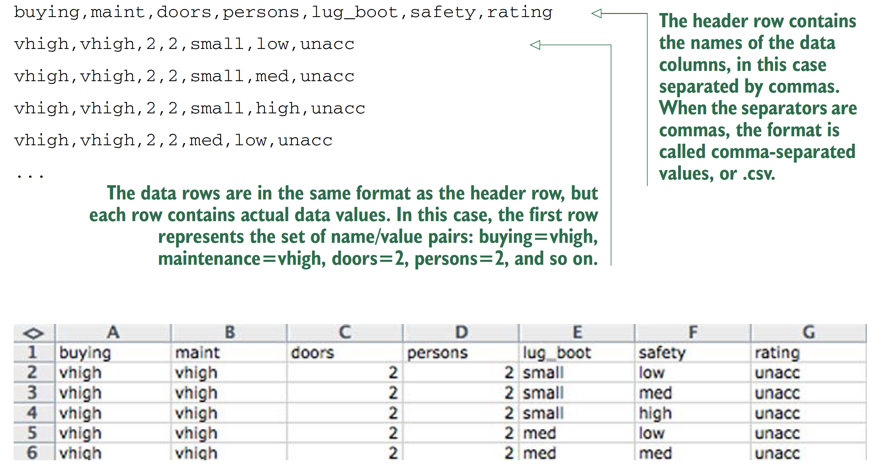
Table-structured data with headers
Practical Data Science with R by Nina Zumel, John Mount

Slide 87
If there is no header in data?
Avoid BY HAND steps
We strongly encourage you to avoid performing any steps “by hand” when importing data. It’s tempting to use an editor to add a header line to a file, as we did in our example. A better strategy is to write a script either outside R (using shell tools) or inside R to perform any necessary reformatting.
Automating these steps greatly reduces the amount of trauma and work during the inevitable data refresh.
Practical Data Science with R by Nina Zumel, John Mount

Slide 88
Reading the UCI car data
loadData.R
uciCar <- read.table( # Note: 1
'http://www.win-vector.com/dfiles/car.data.csv',# Note: 2
sep=',', # Note: 3
header=T # Note: 4
)
# 1: Command to read from a file or URL and store the result in a new data frame object called uciCar.
# 2: Filename or URL to get the data from.
# 3: Specify the column or field separator as a comma.
# 4: Tell R to expect a header line that defines the data column names.
Practical Data Science with R by Nina Zumel, John Mount

Slide 89
Always Exploring your data first
str(uciCar)
summary(uciCar)
dim(uciCar)
Always checking :
# of rows = # of lines of text in the original file - 1
Practical Data Science with R by Nina Zumel, John Mount

Slide 90
Working with other data formats
XLS /XLSX—http://cran.r-project.org/doc/manuals/R-data.html#Reading-Excel-spreadsheets
JSON—http://cran.r-project.org/web/packages/rjson/index.html
XML—http://cran.r-project.org/web/packages/XML/index.html
MongoDB—http://cran.r-project.org/web/packages/rmongodb/index.html
SQL—http://cran.r-project.org/web/packages/DBI/index.html
Practical Data Science with R by Nina Zumel, John Mount

Slide 91
Using R on less-structured data
lessStructure.R
German bank credit dataset
d <- read.table(paste('http://archive.ics.uci.edu/ml/','machine-learning-databases/statlog/german/german.data',sep=''),stringsAsFactors=F,header=F)
head(d)
Practical Data Science with R by Nina Zumel, John Mount

Slide 92
Using R on less-structured data
schema documentation or data dictionary
colnames(d) <- c('Status.of.existing.checking.account',
'Duration.in.month', 'Credit.history', 'Purpose',
'Credit.amount', 'Savings account/bonds',
'Present.employment.since',
'Installment.rate.in.percentage.of.disposable.income',
'Personal.status.and.sex', 'Other.debtors/guarantors',
'Present.residence.since', 'Property', 'Age.in.years',
'Other.installment.plans', 'Housing',
'Number.of.existing.credits.at.this.bank', 'Job',
'Number.of.people.being.liable.to.provide.maintenance.for',
'Telephone', 'foreign.worker', 'Good.Loan')
Practical Data Science with R by Nina Zumel, John Mount

Slide 93
Building a map to interpret loan use codes
d$Good.Loan <- as.factor(ifelse(d$Good.Loan==1,'GoodLoan','BadLoan'))
mapping <- list(
'A40'='car (new)',
'A41'='car (used)',
'A42'='furniture/equipment',
'A43'='radio/television',
'A44'='domestic appliances')
http://archive.ics.uci.edu/ml/datasets/Statlog+(German+Credit+Data)
Practical Data Science with R by Nina Zumel, John Mount

Slide 94
Transforming the car data
for(i in 1:(dim(d))[2]) { # Note: 1
if(class(d[,i])=='character') {
d[,i] <- as.factor(as.character(mapping[d[,i]]))# Note: 2
}
}
summary(d$Purpose)
# 1: (dim(d))[2] is the number of columns in the data frame d.
# 2: Note that the indexing operator [] is vectorized. Each step in the for loop remaps an entire column of data through our list.
Practical Data Science with R by Nina Zumel, John Mount

Slide 95
Summary of Good.Loan and Purpose
the relation of loan type to loan outcome
table(d$Purpose,d$Good.Loan)
Practical Data Science with R by Nina Zumel, John Mount

Slide 96
Summary: Loading data into R
Data frames are your friend.
Use read.table() to load small, structured datasets into R.
Always document data provenance.
Practical Data Science with R by Nina Zumel, John Mount

Slide 97
Version control by Git

Slide 98
Source code management system
a distributed version control system
The development of Git began on 3 April 2005
Torvalds quipped about the name git, which is British English slang meaning "unpleasant person”.
http://git-scm.com/video/what-is-git
https://git-scm.com/downloads
https://git-scm.com/book/en/v2/Getting-Started-Installing-Git

Slide 99
Github
GitHub is a web-based Git repository hosting service.
Development of the GitHub platform began on 1 October 2007.
The site was launched in April 2008 by Tom Preston-Werner, Chris Wanstrath, and PJ Hyett after it had been made available for a few months prior as a beta period.
http://www.howtogeek.com/180167/htg-explains-what-is-github-and-what-do-geeks-use-it-for/

Slide 100
Git vs Github
Git is a revision control system, a tool to manage your source code history. think of it as a series of snapshots (commits) of your code. You see a path of these snapshots, in which order they where created. You can make branches to experiment and come back to snapshots you took.
GitHub is a hosting service for Git repositories. So, it is a web-page on which you can publish your Git repositories and collaborate with other people.
http://stackoverflow.com/questions/13321556/difference-between-git-and-github
http://stackoverflow.com/questions/11816424/understanding-the-basics-of-git-and-github

Slide 101
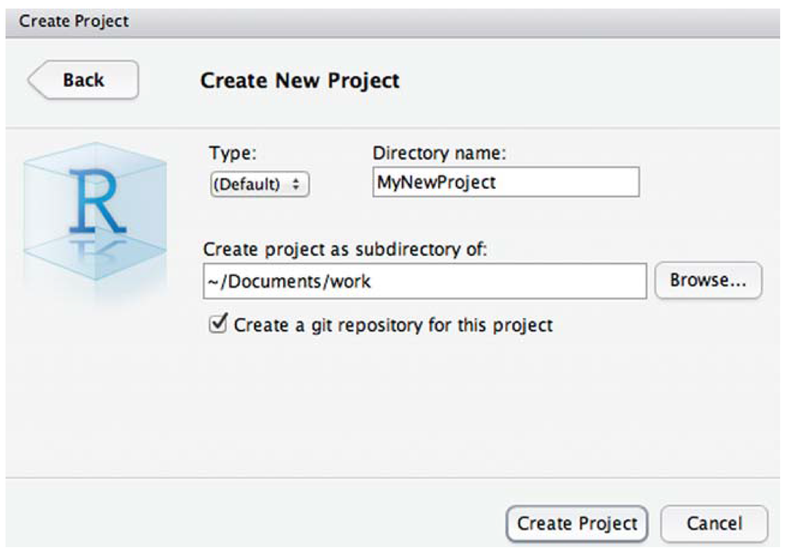
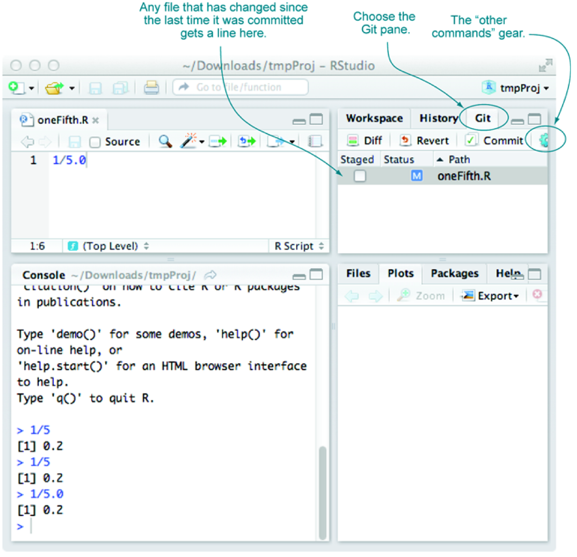
Using Git through RStudio
commit often, and if you’re committing often, all problems can be solved with some further research
Figure 10.7 & 10.8, Practical Data Science with R by Nina Zumel, John Mount

Slide 102
Connect GitHub into RStudio
https://www.r-bloggers.com/rstudio-and-github/

Slide 103
SSH
Version control repositories can typically be accessed using a variety of protocols (including http and https). Many repositories can also be accessed using SSH (this is the mode of connection for many hosting services including GitHub and R-Forge).
In many cases the authentication for an SSH connection is done using public/private RSA key pairs. This type of authentication requires two steps:
Generate a public/private key pair
Provide the public key to the hosting provider (e.g. GitHub or R-Forge)

Slide 104
Generating an SSH key
SSH keys are a way to identify trusted computers without involving passwords. You can generate an SSH key and add the public key to your GitHub account by following the procedures outlined in this section.
https://help.github.com/articles/generating-an-ssh-key/

Slide 105
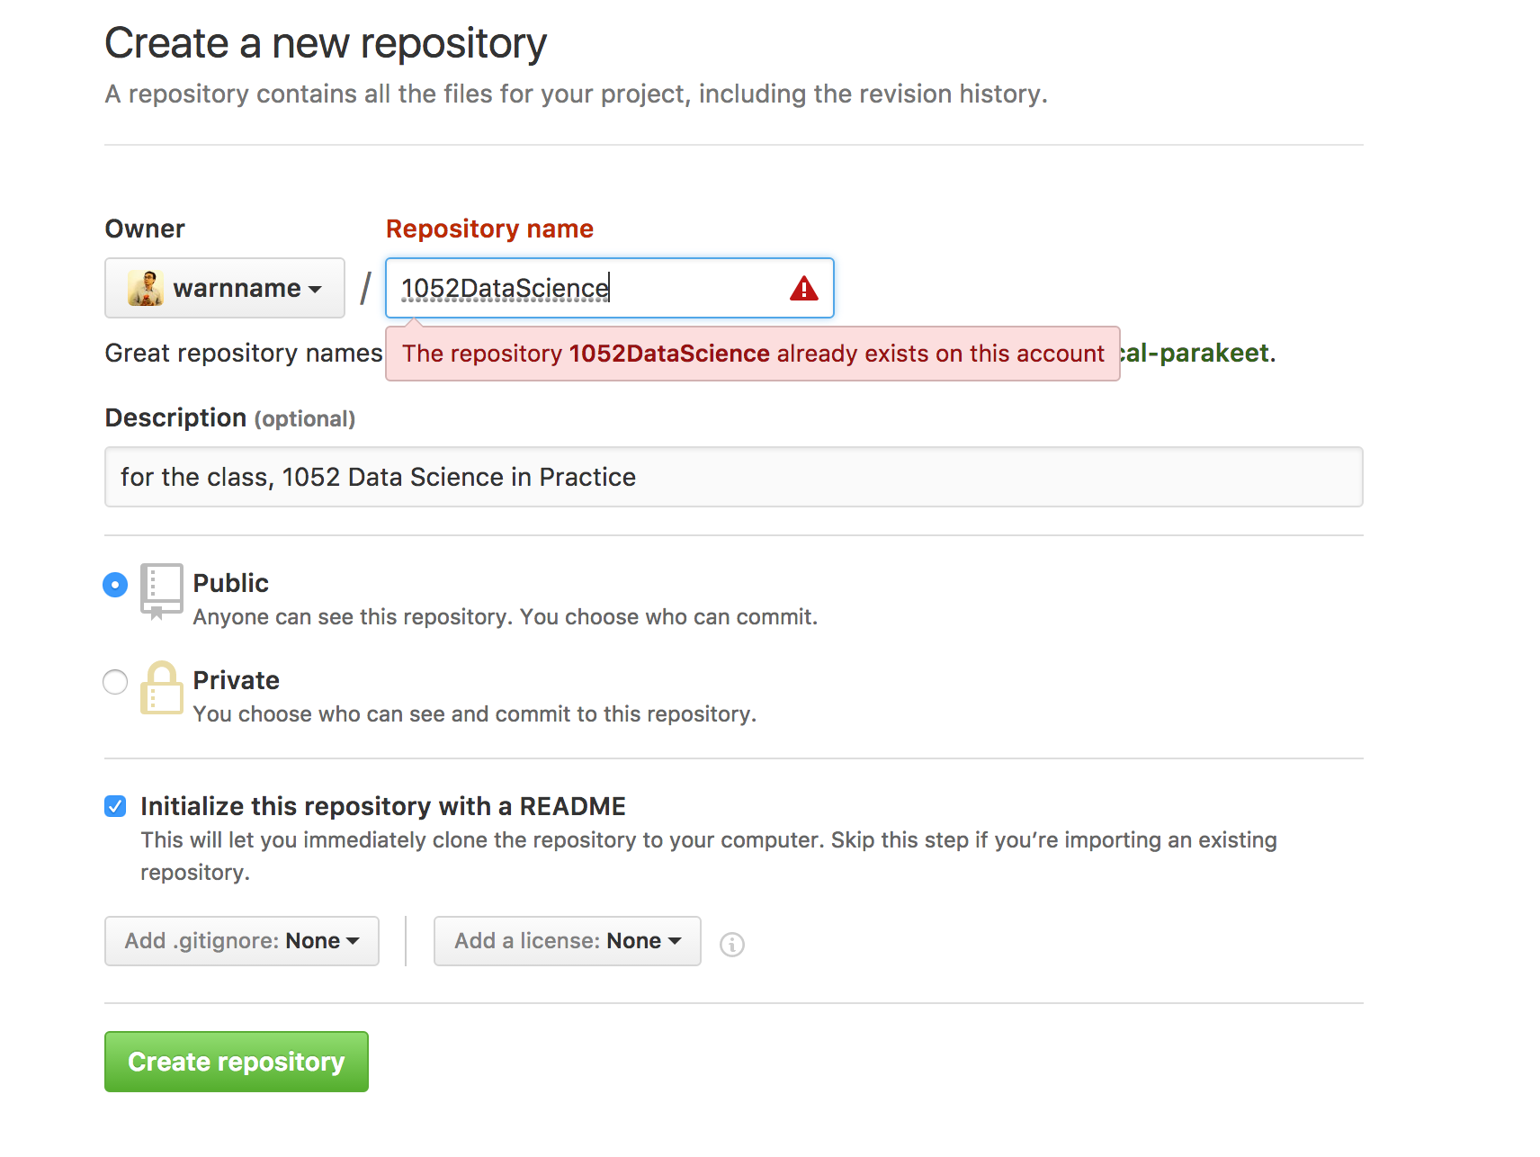

Slide 106
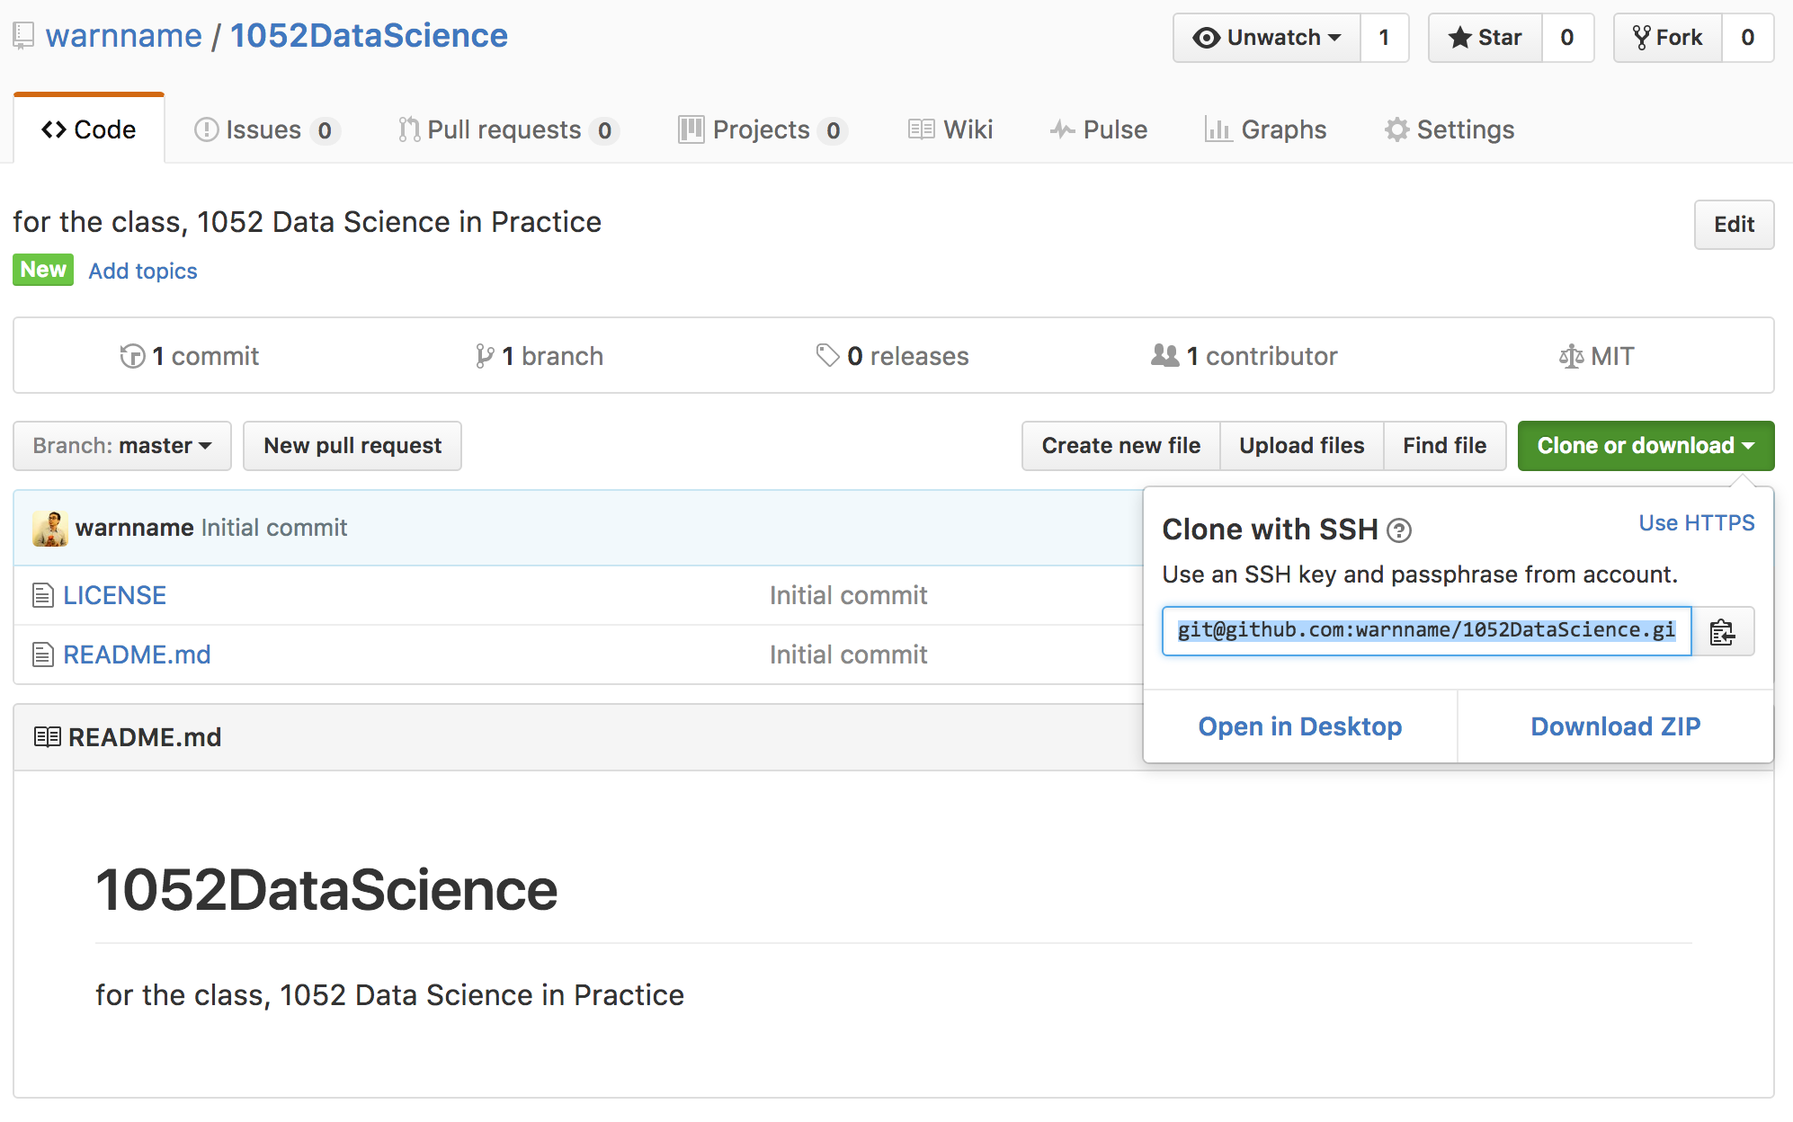

Slide 107
Adding an existing project to GitHub using the command line
creates a new remote called origin located at git@github.com:peter/first_app.git
git remote add origin git@github.com:warnname/1052dataScience.git

Slide 108
Adding an existing project to GitHub using the command line
push the commits in the local branch named master to the remote named origin
git push origin master
Permission denied (publickey).
fatal: Could not read from remote repository.
Please make sure you have the correct access rights and the repository exists.

Slide 109
Commends
git remote add origin https://github.com/warnname/1052DataScience.git
git config remote.origin.url git@github.com:warnname/1052DataScience.git
git pull origin master
git pull --allow-unrelated-histories origin master
git push origin master

Slide 110
Starting a git project using the command line
Create folder
Homework1
Data
Scripts
Derived
Results
git init .
git config --global user.name "jia-ming.chang”
git config --global user.email chang.jiaming@gmail.com
git status

Slide 111
Starting a git project using the command line
cp code03/.
touch Derived/tmp
git status
vi .gitignore
git status
Practical Data Science with R by Nina Zumel, John Mount

Slide 112
Using add/commit pairs to checkpoint work
git add -A .
git commit -m "include template file for example3”
A “wimpy commit” is better than no commit
Practical Data Science with R by Nina Zumel, John Mount

Slide 113
Finding out who wrote and when
git blame Scripts/week3_2.R
git log
git log --graph --name-status
Practical Data Science with R by Nina Zumel, John Mount

Slide 114
Git commends
Local
git init .
git add -A .
git commit
git status
git log
git diff
git checkout
Public
git pull
git rebase
git push
https://www.git-tower.com/blog/git-cheat-sheet/

Slide 115
https://github.github.com/training-kit/downloads/github-git-cheat-sheet.pdf

Slide 116


Thank You Any Question?

